Slide 1

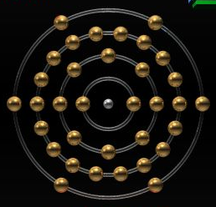
Selenium
Using Selenium for Web Testing
Software Quality Assurance
Telerik Software Academy
http://academy.telerik.com

Slide 2


The Lectors
Snejina Lazarova
Project Manager
BI & Reporting Team
Dimo Mitev
QA Architect
Backend Services Team

Slide 3

Table of Contents
Selenium
What is Selenium?
Selenium IDE
Limitations
Features
Test Cases
Test Suits
Commands
Locating elements
Some Final Considerations

Slide 4

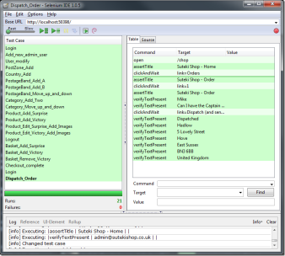
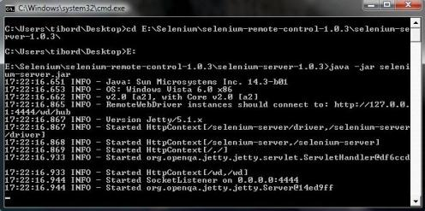
Selenium

Slide 5
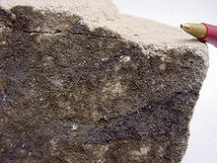

Origins of Selenium
History:
Firstly developed as a JavaScript library by Thought Works to automatically rerun tests against multiple browsers
Selenium is the key mineral to protect body from mercury toxicity

Slide 6

What is Selenium?
What is Selenium?
A JavaScript based web testing tool
Very popular Open Source tool
Supports testing Web 2.0 applications
On multiple browsers
And multiple Operating Systems
Source:
http://seleniumhq.org/

Slide 7
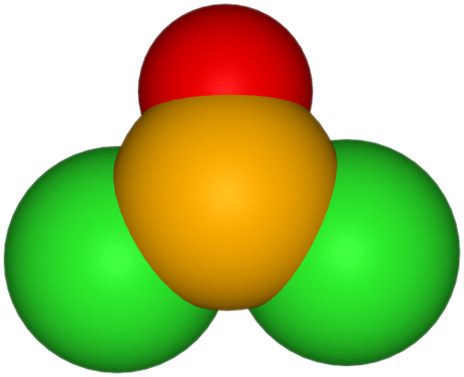
What is Selenium? (2)
Tests run directly in browser
Implemented entirely using browser technologies
JavaScript
DHTML
Frames

Slide 8

Selenium’s Tool Suite
Selenium is set of different software tools
Each has a specific role and a different approach to supporting test automation:
Selenium IDE (Integrated Development Environment)
Selenium 1 (Selenium RC or Remote Control)
Selenium-Grid
Selenium 2 (Selenium WebDriver)

Slide 9

Areas of Application
Selenium can be used for:
Acceptance / Functional testing
Reproducing bugs
Unit-testing
Regression testing
Smoke-testing

Slide 10
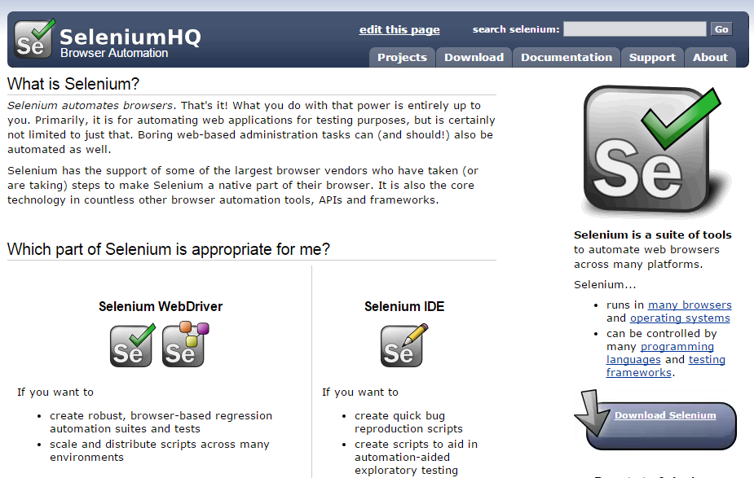
Selenium Quick Demo
http://seleniumhq.org/
Notes:
Quick demo of Selenium's website and download sources.

Slide 11
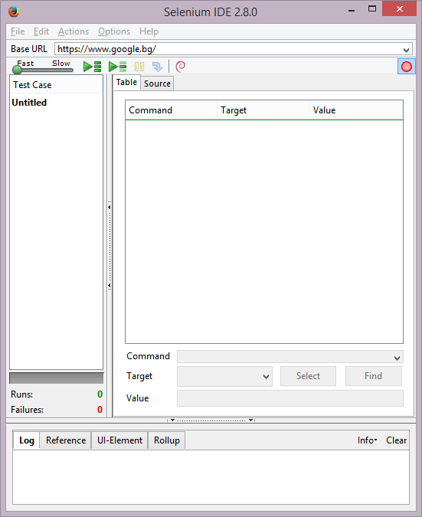

Selenium IDE
Test Record and Playback

Slide 12
Selenium IDE
Selenium IDE is a prototyping tool for building test scripts
It is a Firefox plugin
Provides an easy-to-use interface for developing automated tests
Selenium IDE has a recording feature
Records user actions as they are performed
Exports them as a reusable script in a chosen programming language
The script can be later executed

Slide 13
Selenium IDE Limitations
Selenium IDE is simply intended as a rapid prototyping tool
Not designed to run test passes
Not designed to build all the automated tests you would need
Doesn’t provide iteration or conditional statements for test scripts
For serious test automation either Selenium 2 or Selenium 1 should be used
With a supported programming language

Slide 14
Building Test Cases
There are three primary methods for developing test cases:
Recording
Adding Verifications and Asserts With the Context Menu
Editing
Editing commands and comments
Test cases can be grouped in test suites

Slide 15
Recording Test Cases
Useful for beginner users
Selenium-IDE automatically inserts commands into your test case based on your actions
Clicking a link - click or clickAndWait commands
Entering values - type command
Selecting options from a drop-down listbox - select command
Clicking checkboxes or radio buttons - click command

Slide 16
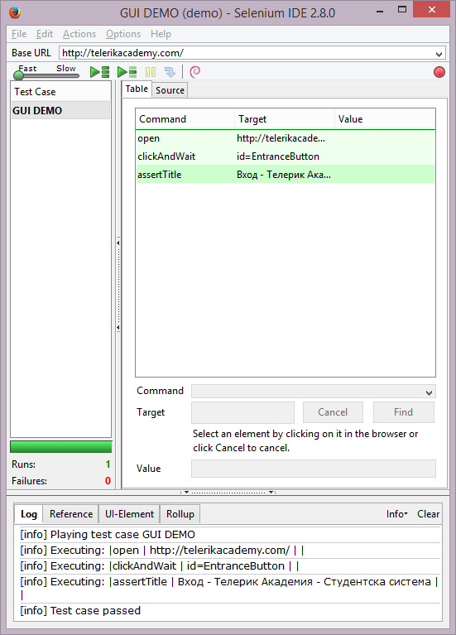
IDE Main Features Demo
Menu Bar
Test Case Pane
Toolbar
Log/Reference/UI-Element/ Rollup Pane

Slide 17
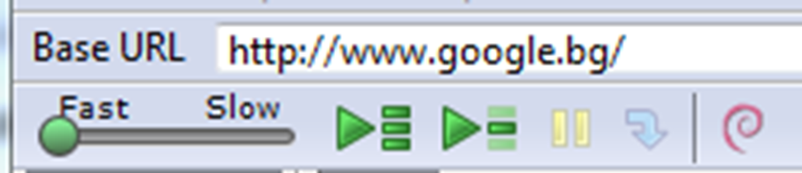

Base URL
The Selenium IDE allows pointing a base URL
Allowing test cases to be run across different domains

Slide 18
Selenium Commands – “Selenese”
Selenium commands, often called Selenese, are the set of commands that run your tests
These commands essentially create a testing language
A sequence of these commands is a test script
css=input[name="username"]

Slide 19
What Can We Test
In selenese we can test:
Existence of UI elements based on their HTML tags
Test for specific content
Test for broken links
Input fields, selection list options, submitting forms, and table data
Window size, mouse position, alerts, Ajax functionality, pop up windows, event handling
Etc.

Slide 20
Script Syntax
Selenium commands are simple, they consist of the command and two parameters
The parameters are not always required - it depends on the command
Some cases require both, one or no parameters
verifyText | //div//a[2] | Login
goBackAndWait verifyTextPresent type type | id=phone id=address1 | Welcome to My Home Page (555) 666-7066 ${myVariableAddress}

Slide 21
Selenium Parameters
Parameters vary, however they are typically:
A locator for identifying a UI element within a page
A text pattern for verifying or asserting expected page content
A text pattern or a selenium variable for entering text in an input field or for selecting an option from an option list

Slide 22

Storing Selenium Scripts
Scripts for Selenium-IDE are stored in HTML text file format
This consists of an HTML table with three columns:
Command
Target
Value
The second and third columns may not require values but they should be present

Slide 23
Storing Selenium Scripts (2)
Here is an example of a test:
<table>
<tr>
<td>open</td>
<td></td>
<td>/download/</td>
</tr>
<tr>
<td>assertTitle</td>
<td></td>
<td>Downloads</td>
</tr>
<tr>
<td>verifyText</td>
<td>//h2</td>
<td>Downloads</td>
</tr>
</table>
Rendered as a table in a browser this would look like the following:
open assertTitle verifyText | //h2 | /download/ Downloads Downloads

Slide 24

Test Suites
A test suite is a collection of tests
Test suites allow running the tests all at once, one after another as a one continuous batch-job

Slide 25
Test Suites (2)
Test suites also can be defined using a simple HTML file
<html>
<head>
<title>Test Suite Function Tests - Priority 1</title>
</head>
<body>
<table>
<tr><td><b>Suite Of Tests</b></td></tr>
<tr><td><a href= "./Login.html" >Login</a></td></tr>
<tr><td><a href= "./SearchValues.html" >Test Searching for Values</a></td></tr>
<tr><td><a href="./SaveValues.html" >Test Save</a></td> </tr>
</table>
</body>
</html>

Slide 26


Selenium Commands
A command is what tells Selenium "what to do"
Selenium commands come in three “flavors”:
Actions
Accessors
Assertions

Slide 27

Actions
Actions are commands that generally manipulate the state of the application
They do things like:
“click this link” (click command)
“select that option” (select command)
Etc.
If an Action fails, or has an error, the execution of the current test is stopped

Slide 28

The "AndWait" Actions
Many Actions can be called with the “AndWait” suffix,
E.g. “clickAndWait”
When the browser makes a call to the server
Forces Selenium to wait for a new page to load
Continuing to run commands before the page has loaded all its UI elements causes unexpected test case failures
Do not use for actions that do not trigger a navigation/refresh

Slide 29


Accessors
Accessors examine the state of the application and store the results in variables
E.g. “storeTitle”
They are also used to automatically generate Assertions

Slide 30


Assertions
Assertions are like Accessors, but they verify that the state of the application conforms to what is expected
E.g., “make sure the page title is X” (assertTitle) and “verify that this checkbox is checked” (verifyText)

Slide 31
Assertion Modes
All Selenium Assertions can be used in 3 modes:
“assert”
When fails the test is aborted
“verify”
When fails, the test continues execution, logging the failure
”waitFor”
Waits for some condition to become true
Aborts the test when fails

Slide 32
Assertion or Verification?
Choosing between “assert” and “verify” comes down to convenience and management of failures
There is no point checking a paragraph if you are not on the correct page
On the other hand, you may want to check many attributes of a page without aborting the test case
Usually each command group is started with an “assert” followed by one or more “verify” test commands

Slide 33
Some Common Selenium Commands
These are some of the most commonly used commands:
open - opens a page using a URL
click/clickAndWait - performs a click operation, and optionally waits for a new page to load
verifyTitle/assertTitle - verifies an expected page title
verifyTextPresent - verifies expected text is somewhere on the page

Slide 34

Some Common Selenium Commands (2)
verifyElementPresent - verifies an expected UI element, as defined by its HTML tag, is present on the page
verifyText - verifies expected text and it’s corresponding HTML tag are present on the page
verifyTable - verifies a table’s expected contents

Slide 35

Some Common Selenium Commands (3)
waitForPageToLoad - pauses execution until an expected new page loads
Called automatically when clickAndWait is used
waitForElementPresent - pauses execution until an expected UI element, as defined by its HTML tag, is present on the page

Slide 36

Verifying Page Elements
Verifying UI elements on a web page is probably the most common feature
Selenese allows multiple ways of checking for UI elements. E.g.:
Is an element present somewhere on the page?
Is a specific text - somewhere on the page?
Is a specific text at a specific location on the page?

Slide 37
"verifyTextPresent"
The command verifyTextPresent
Used to verify specific text exists somewhere on the page
It takes a single argument - the text pattern to be verified
Command | Target | Value
verifyTextPresent | Marketing Analysis

Slide 38
"verifyElementPresent"
The command verifyElementPresent
Use this command when you must test for the presence of a specific UI element, rather then its content
This verification does not check the text, only the HTML tag
One common use is to check for the presence of an image
Command | Target | Value
verifyElementPresent | //div/p/img

Slide 39
"verifyText"
The command verifyText
Verifies both the text and its UI element
It must use a locator
Command | Target | Value
verifyText | //table/tr/td/div/p | This is my text and it occurs right after the div inside the table.

Slide 40

Locating Elements
For many Selenium commands, a target is required
Identifies an element in the content of the web application
Consists of the location strategy followed by the location in the format: locatorType=location
The locator type can be omitted in many cases

Slide 41
Locating by Identifier
Locating by identifier is the most common method of locating elements
A catch-all default when no recognized locator type is used
The first element with the id attribute value matching the location is used
If no element has a matching id attribute, then the first element with a name attribute matching the location is used

Slide 42
Locating by Identifier - Example
Source code:
1 <html>
2 <body>
3 <form id= "loginForm" >
4 <input name= "username" type= "text" />
5 <input name= "password" type= "password" />
6 <input name= "continue" type= "submit" value= "Login" />
7 </form>
8 </body>
9 <html>
Locator strategy | Row of returned element
identifier=loginForm | 3
identifier=password | 5
identifier=continue | 6
continue | 6
Since identifier= is the default locator, it can be ommited

Slide 43


Locating by Id
Locating by Id is more limited than the identifier locator type, but also more explicit
Use it when you know an element's id attribute

Slide 44
Locating by Id - Example
Source code:
1 <html>
2 <body>
3 <form id= "loginForm" >
4 <input name= "username" type= "text" />
5 <input name= "password" type= "password" />
6 <input name= "continue" type= "submit" value= "Login" />
7 <input name= "continue" type= "button" value= "Clear" />
8 </form>
9 </body>
10 <html>
Locator strategy | Row of returned element
id=loginForm | 3

Slide 45

Locating by Name
The name locator type will locate the first element with a matching name attribute
If multiple elements have the same value for a name attribute, then you can use filters to further refine your location strategy
The default filter type is value (matching the value attribute)

Slide 46
Locating by Name - Example
Source code:
1 <html>
2 <body>
3 <form id= "loginForm" >
4 <input name= "username" type= "text" />
5 <input name= "password" type= "password" />
6 <input name= "continue" type= "submit" value= "Login" />
7 <input name= "continue" type= "button" value= "Clear" />
8 </form>
9 </body>
10 <html>
value= is omitted as a default filter type
Locator strategy | Row of returned element
name=username | 4
name=continue value=Clear | 7
name=continue Clear | 7
name=continue type=button | 7

Slide 47
Locating by XPath
XPath is the language used for locating nodes in an XML (XHTML) document
Useful when we don’t have a suitable id or name attribute for the element
XPath locators can also be used to specify elements via attributes other than id and name
Since only xpath locators start with “//”, the xpath= label can be omitted
xpath=

Slide 48
Absolute vs. Relative Location
Types of XPath location:
Absolute
Contains the location of all elements from the root (html) (E.g., xpath=/html/body/form)
Very likely to fail after adjustments
Relative
Relative to an element that does have an id or name attribute
E.g., //input[@name=’username’] - First input element with attribute named ‘name’ and the value ‘username’

Slide 49
Locating by Xpath - Example
1 <html>
2 <body>
3 <form id= "loginForm" >
4 <input name= "username" type= "text" />
5 <input name= "password" type= "password" />
6 <input name= "continue" type= "submit" value= "Login" />
7 <input name= "continue" type= "button" value= "Clear" />
8 </form>
9 </body>
10 <html>
Locator strategy | Row of returned element
xpath=/html/body/form[1] | 3
//form[1] | 3
xpath=//form[@id=’loginForm’] | 3
xpath=//form[input/\@name=’username’] | 4
Notes:
• xpath=/html/body/form[1] (3) - Absolute path (would break if the HTML was changed
only slightly)
• //form[1] (3) - First form element in the HTML
• xpath=//form[@id=’loginForm’] (3) - The form element with attribute named ‘id’ and
the value ‘loginForm’
• xpath=//form[input/\@name=’username’] (4) - First form element with an input
child element with attribute named ‘name’ and the value ‘username’

Slide 50
Locating by Xpath – Example (2)
1 <html>
2 <body>
3 <form id= "loginForm" >
4 <input name= "username" type= "text" />
5 <input name= "password" type= "password" />
6 <input name= "continue" type= "submit" value= "Login" />
7 <input name= "continue" type= "button" value= "Clear" />
8 </form>
9 </body>
10 <html>
Locator strategy | Row of returned element
//input[@name=’username’] | 4
//form[@id=’loginForm’]/input[1] | 4
//input[@name=’continue’][@type=’button’] | 7
//form[@id=’loginForm’]/input[4] | 7
Notes:
• //input[@name=’username’] (4) - First input element with attribute named ‘name’ and
the value ‘username’
• //form[@id=’loginForm’]/input[1] (4) - First input child element of the form element
with attribute named ‘id’ and the value ‘loginForm’
• //input[@name=’continue’][@type=’button’] (7) - Input with attribute named
‘name’ and the value ‘continue’ and attribute named ‘type’ and the value ‘button’
• //form[@id=’loginForm’]/input[4] (7) - Fourth input child element of the form element
with attribute named ‘id’ and value ‘loginForm’

Slide 51
Resources for XPath
Some useful links:
http://www.w3schools.com/Xpath/
http://www.w3.org/TR/xpath/
http://www.zvon.org/xxl/XPathTutorial/General/examples.html
Useful Firefox Add-on that can assist in discovering the XPath of an element:
https://addons.mozilla.org/en-US/firefox/addon/firebug/

Slide 52
Locating Hyperlinks by Link Text
Hyperlink can be located in the web page by using the text of the link
If two links with the same text are present, then the first match will be used
1 <html>
2 <body>
3 <p>Are you sure you want to do this?</p>
4 <a href= "continue.html">Continue</a>
5 <a href= "cancel.html">Cancel</a>
6 </body>
7 <html>
Locator strategy | Row of returned element
link=Continue | 4
link=Cancel | 5

Slide 53
Locating by DOM
The Document Object Model (DOM) represents an HTML document and can be accessed using JavaScript
Takes JavaScript that evaluates to an element on the page
Can be simply the element’s location using the hierarchical dotted notation
Since only dom locators start with “document”, the dom= label can be omitted

Slide 54
Locating by DOM - Example
1 <html>
2 <body>
3 <form id= "loginForm" >
4 <input name= "username" type= "text" />
5 <input name= "password" type= "password" />
6 <input name= "continue" type= "submit" value= "Login" />
7 <input name= "continue" type= "button" value= "Clear" />
8 </form>
9 </body>
10 <html>
Locator strategy | Row of returned element
dom=document.getElementById(’loginForm’) | 3
dom=document.forms[’loginForm’] | 3
dom=document.forms[0] | 3
document.forms[0].username | 4
Notes:
• xpath=/html/body/form[1] (3) - Absolute path (would break if the HTML was changed
only slightly)
• //form[1] (3) - First form element in the HTML
• xpath=//form[@id=’loginForm’] (3) - The form element with attribute named ‘id’ and
the value ‘loginForm’
• xpath=//form[input/\@name=’username’] (4) - First form element with an input
child element with attribute named ‘name’ and the value ‘username’

Slide 55
Locating by DOM – Example (2)
1 <html>
2 <body>
3 <form id= "loginForm" >
4 <input name= "username" type= "text" />
5 <input name= "password" type= "password" />
6 <input name= "continue" type= "submit" value= "Login" />
7 <input name= "continue" type= "button" value= "Clear" />
8 </form>
9 </body>
10 <html>
Locator strategy | Row of returned element
document.forms[0].elements[’username’] | 4
document.forms[0].elements[0] | 4
document.forms[0].elements[3] | 7
Notes:
• xpath=/html/body/form[1] (3) - Absolute path (would break if the HTML was changed
only slightly)
• //form[1] (3) - First form element in the HTML
• xpath=//form[@id=’loginForm’] (3) - The form element with attribute named ‘id’ and
the value ‘loginForm’
• xpath=//form[input/\@name=’username’] (4) - First form element with an input
child element with attribute named ‘name’ and the value ‘username’

Slide 56
Locating by CSS
CSS (Cascading Style Sheets) is a language for describing the rendering of HTML and XML documents
CSS uses Selectors for binding style properties to elements in the document
These Selectors can be used by Selenium as another locating strategy
Faster than Xpath
Can find the most complicated objects in an intrinsic HTML document

Slide 57
Locating by CSS - Example
1 <html>
2 <body>
3 <form id= "loginForm" >
4 <input class= "required" name= "username" type= "text"/>
5 <input class= "required passfield" name= "password" 6 type= "password" />
7 <input name= "continue" type= "submit" value= "Login" />
8 <input name= "continue" type= "button" value= "Clear" />
9 </form>
10 </body>
11 <html>
Locator strategy | Row of returned element
css=form#loginForm | 3
css=input[name="username"] | 4
css=input.required[type="text"] | 4

Slide 58
Locating by CSS – Example (2)
1 <html>
2 <body>
3 <form id= "loginForm" >
4 <input class= "required" name= "username" type= "text"/>
5 <input class= "required passfield" name= "password" 6 type= "password" />
7 <input name= "continue" type= "submit" value= "Login" />
8 <input name= "continue" type= "button" value= "Clear" />
9 </form>
10 </body>
11 <html>
Locator strategy | Row of returned element
css=input.passfield | 5
css=#loginForm input[type="button"] | 8
css=#loginForm input:nth-child(2) | 5

Slide 59
Implicit Locators
Locator type can be omitted in the following situations:
Locators without an explicitly defined locator strategy will default to using the identifier locator strategy
Locators starting with “//” will use the XPath locator strategy
Locators starting with “document” will use the DOM locator strategy

Slide 60
Matching Text Patterns
Like locators, patterns are a type of parameter frequently required by Selenese commands
E.g., verifyTextPresent, verifyTitle, verifyAlert, assertConfirmation, verifyText, and verifyPrompt
Link locators can utilize a pattern
Patterns allow describing what text is expected via the use of special characters
Rather than having to specify that text exactly

Slide 61


Pattern Types
There are three types of patterns:
Globbing patterns
Regular expressions patterns
Exact patterns

Slide 62
Globbing Patterns
Selenium globbing patterns support only two special characters:
"*" (asterisk) - translates to “match anything,” i.e., nothing, a single character, or many characters
[ ] (character class) - translates to “match any single character found inside the square brackets” – e.g., [aeiou]
A dash (hyphen) can be used as a shorthand to specify a range of characters – e.g., [a-zA-Z0-9]

Slide 63
Globbing Patterns Prefix
Globbing patterns are prefixed with a glob: label
Since globbing patterns are the default pattern – the label can be omitted
Command | Target | Value
verifyTitle | glob:Film*Television*
Command | Target | Value
verifyTitle | Film*Television*

Slide 64
Globbing Patterns Example
Command | Target | Value
click | link=glob:Film*Television Department
verifyTitle | glob:*Film*Television*
The actual link text on the page being tested can be “Film/Television Department”
It will work even if the link text is changed to “Film & Television Department” or “Film and Television Department”
The actual title of the page can be
“De Anza Film And Television Department - Menu”
“Film & Television Department”

Slide 65
Regular Expression Patterns
Selenium regular expressions support the same wide array of special characters as JavaScript :
PATTERN | MATCH
. | any single character
[ ] | character class: any single character that appears inside the brackets
* | quantifier: 0 or more of the preceding character (or group)
+ | quantifier: 1 or more of the preceding character (or group)
? | quantifier: 0 or 1 of the preceding character (or group)
{1,5} | quantifier: 1 through 5 of the preceding character (or group)
| | alternation: the character/group on the left or the character/group on the right
( ) | grouping: often used with alternation and/or quantifier
 | Etc., …

Slide 66

Regular Expression Patterns (2)
The most commonly used regular expression pattern is ".*" ("dot star")
“0 or more occurrences of any character”
Regular expression patterns in Selenese need to be prefixed with one of two possibilities:
regexp:
(Case-sensitive)
regexpi:
(Case insensitive)

Slide 67
Regular Expression Patterns Example
Example:
Command | Target | Value
Open | http://sinoptik.bg/
verifyTextPresent | regexp: [0-9]{1,2}:[0-9]{2}
Pattern | Explanation
[0-9]{1,2} | 1 or 2 digits (for the hour of the day)
: | The character ":" (no special character involved)
[0-9]{2} | 2 digits (for the minutes) followed by a space

Slide 68
Exact Patterns
Exact patterns use no special characters
They are used with exact: prefix
Used when a special character need to be used as a literal
Example: looking for an item labeled "Real *"
Matches anything or nothing after "Real"
select | //select | glob:Real *
select | //select | exact:Real *
Matches the exact pattern
select | //select | regexp:Real \*
Escaping is also possible

Slide 69
"waitFor" Commands for AJAX Applications
Using andWait commands will not work In AJAX driven web applications
Data is retrieved from server without refreshing the page
We can use waitFor, waitForElementPresent or waitForVisible commands
They check for the desired condition every second and continue as soon as the condition is met

Slide 70
Store Commands and Selenium Variables
Selenium variables can be used to store constants at the beginning of a script
Can be used to store values passed to your test program from the command-line, from another program, or from a file
Storing values with the store command
Command | Target | Value
store | paul@mysite.org | userName
The text value to be stored
The selenium variable

Slide 71
Using The Stored Values
Accessing the stored value
Done by enclosing the variable in curly brackets ({}) and preceded by a dollar sign - ${ … }
Command | Target | Value
verifyText | //div/p | ${userName}
A common use of variables is for storing input for an input field
Command | Target | Value
type | id=login | ${userName}

Slide 72
Other Store Commands
storeElementPresent
Corresponds to verifyElementPresent
Stores a boolean value–“true” or “false”–depending on whether the UI element is found
storeText
Corresponds to verifyText
Uses a locater to identify specific page text - if found, it is stored in the variable
StoreText can be used to extract text from the page being tested

Slide 73

Other Store Commands (2)
storeEval
Takes a script as its first parameter
Allows the test to store the result of running the script in a variable
An equivalent store command exists for each verify and assert command

Slide 74
JavaScript Usage with Script Parameters
Several Selenese commands specify a script parameter
assertEval, verifyEval, storeEval, and waitForEval
A snippet of JavaScript code can is simply put into the appropriate field
Command | Target | Value
store | 10 | hits
storeXpathCount | //blockquote | blockquotes
storeEval | storedVars[’hits’]-storedVars[’blockquotes’] | paragraphs

Slide 75
Methods Calling With JavaScript
A JavaScript snippet can include calls to methods
E.g., JavaScript String object’s toUpperCase method and toLowerCase method:
Command | Target | Value
store | Edith Wharton | hits
storeEval | storedVars[’name’].toUpperCase() | uc
storeEval | storedVars[’name’].toLowerCase() | lc

Slide 76
Using JavaScript With Non-Script Parameters
JavaScript can also be used even when the parameter is not specified to be of type script
The JavaScript snippet must be enclosed inside curly braces preceded by the label javascript
javascript{*yourCodeHere*}
Command | Target | Value
store | league of nations | searchString
type | q | javascript{storedVars[’searchString’].toUpperCase()}

Slide 77
echo - The Selenese Print Command
Selenese has a simple command that allows printing text to the test’s output
Useful for providing informational progress notes in your test
Displays on the console as the test is running
Command | Target | Value
Echo | Testing page footer now.
Echo | Username is ${userName}

Slide 78
Debugging
Selenium supports some useful debugging features
Breakpoints and startpoints
Stepping through a testcase
Executing a test case one command at a time
Find button
Seeing which UI element on the currently displayed webpage (in the browser) is used in the currently selected Selenium command

Slide 79
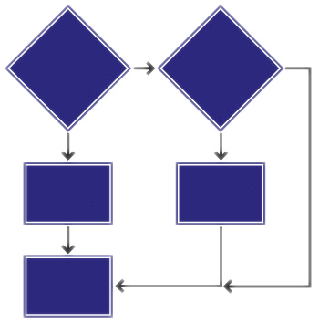
Sequence of Evaluation and Flow Control
Selenium scripts runs in sequence, one command after another
Selenese, by itself, does not support condition statements (if-else, etc.) or iteration (for, while, etc.)

Slide 80

Sequence of Evaluation and Flow Control (2)
When flow control is needed, there are a couple of options:
Run the script using Selenium-RC and a client library such as C# or PHP
Run a small JavaScript snippet from within the script using the storeEval command
Install the goto_sel_ide.js extension
Install Selenium IDE Flow Control add-on to Firefox

Slide 81
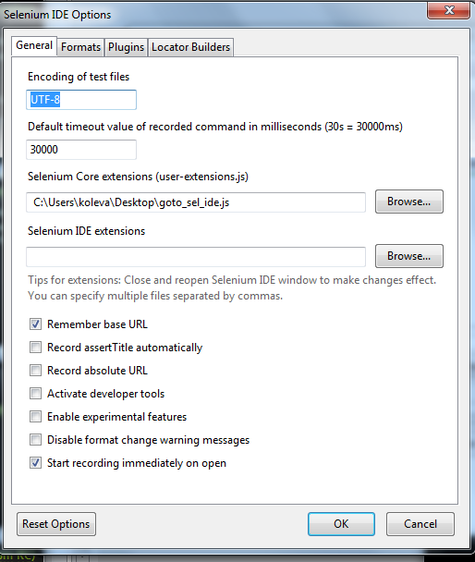
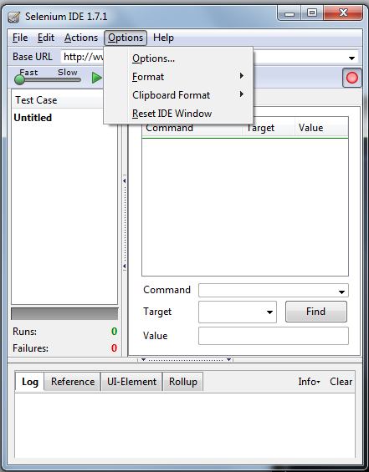
How to Add User Extensions
Open Selenium
Go to Menu Options/Options
Browse your extension and select it in Selenium Core extensions or Selenium IDE extension
Restart Selenium

Slide 82
Flow Control Extension
When do we use it:
some steps of the test should be skipped if condition is satisfied
If we’re logged in, we can skip log in steps
If we need to add iterations
while loop can be used as a command
Command | Target | Value
store | 0 | loop1
while | storedVars.loop1<2
…
endWhile

Slide 83
Flow Control Extension (2)
Adding conditions to the tests
Before you start: add goto_sel_ide.js to Selenium as user extension
Labels in the tests
Used as markers in the tests
gotoif command
label | labelName
gotoif | storedVars[‘Name']==1 | labelName

Slide 84

Some Final Considerations

Slide 85

Problems With HTML Tests
Selenium is sensitive to the format of the table
Duplication is a major issue
Tests need to be deployed with AUT (Application Under Test)

Slide 86
Table or Driver Based?
Table based approach is fine for simple tests
No programming required
Doesn't scale – duplication is a major issue
Driver approach better for 'Real' test suites
Can develop tests in language of choice:
C#, Java, Ruby, Python, Perl
Easier data management via DB / Excel

Slide 87

Ajax Support
Selenium supports testing Web 2.0 applications
Monitor the DOM for completion of Async calls
waitForCondition()
waitForValue()

Slide 88

Continuous Integration
Run Selenium tests as part of the build
Works with both Core and Driven modes
Each time a developer checks in, if necessary
Can generate HTML reports, published to entire team
Helps catch bugs ASAP
Addresses risk of catching bugs late in the cycle

Slide 89
Selenium
?
?
?
?
?
Questions?
?
?
?
?
?
?

Slide 90
Exercises
Using the Selenium IDE record a test case that performs the following actions:
Opens the Telerik Academy web page: http://academy.telerik.com/
Navigates to the Start page
Ensures that the text “Предстоящи курсове” is present on the page

Slide 91
Exercises (2)
Using the Selenium IDE record a test case that performs the following actions:
Navigates to the site: http://www.worldwidemetric.com/cal.html
Asserts that the header "Length Conversion Calculator" is present on the page
Inserts value 10 in the Meter field
Presses the respective "Calculate" button
Asserts that the Centimeters field gets the value 1000

Slide 92
Exercises (3)
Using the Selenium IDE record a test case that performs the following actions:
Navigates to http://www.google.com in Firefox
Types “Testing Geek” in the Google search bar and click Search
On the search results verify that “Software Testing Geek” is present at the first place
Save the test case as google_ide.html
Run the saved test case back again using the IDE
View the results back in the IDE

Slide 93
Exercises (4)
Read the Selenium Documentation at address: http://docs.seleniumhq.org/docs/
Find more information about Selenium in the Internet

Slide 94




Free Trainings @ Telerik Academy
C# Programming @ Telerik Academy
csharpfundamentals.telerik.com
Telerik Software Academy
academy.telerik.com
Telerik Academy @ Facebook
facebook.com/TelerikAcademy
Telerik Software Academy Forums
forums.academy.telerik.com

